Slide 1
IBM Cloud

Slide 2
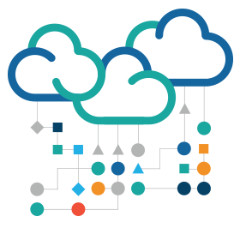
Cloud Computing
An estimated 85% of new software is being built for cloud deployment
Cloud Computing is a broad term that describes a range of services
Infrastructure as a Service (IaaS)
Hardware / software – servers, storage, networks, operating systems
Platform as a Service (PaaS)
Set of tools and services designed for application development
Software as a Service (SaaS)
Designed for end users, delivered over the web

Slide 3
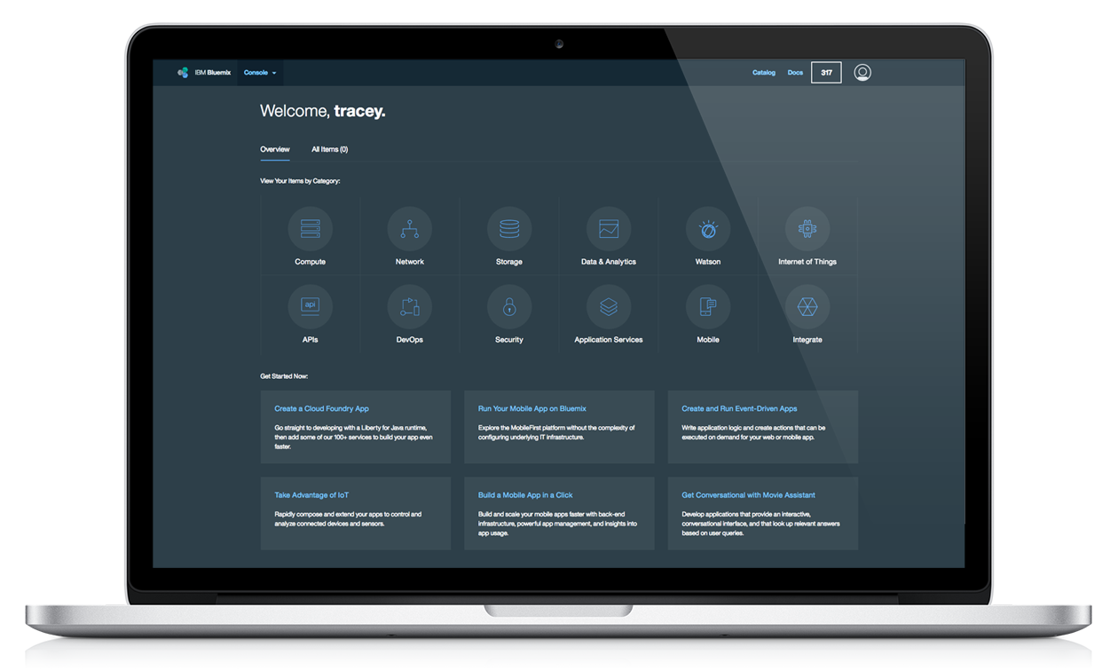
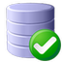


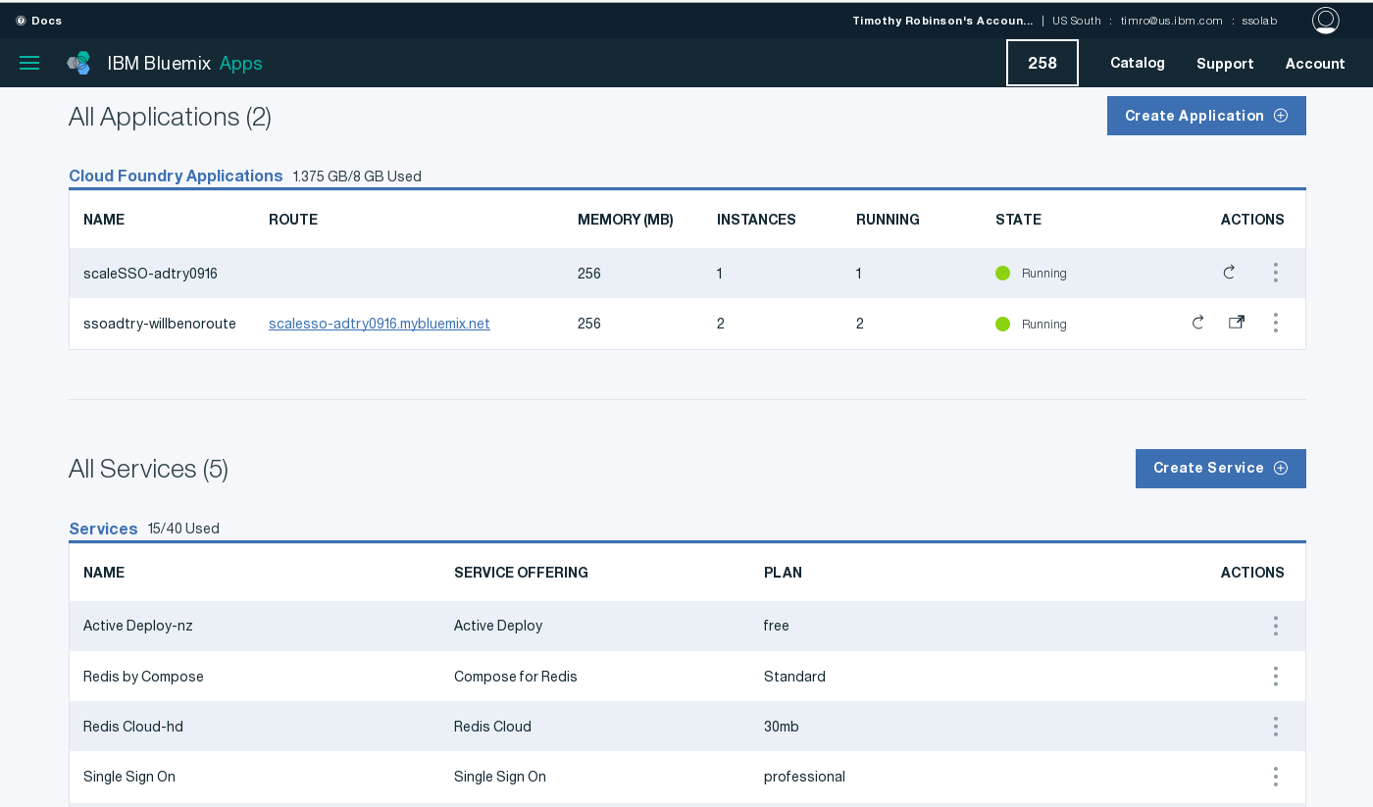



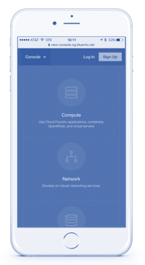
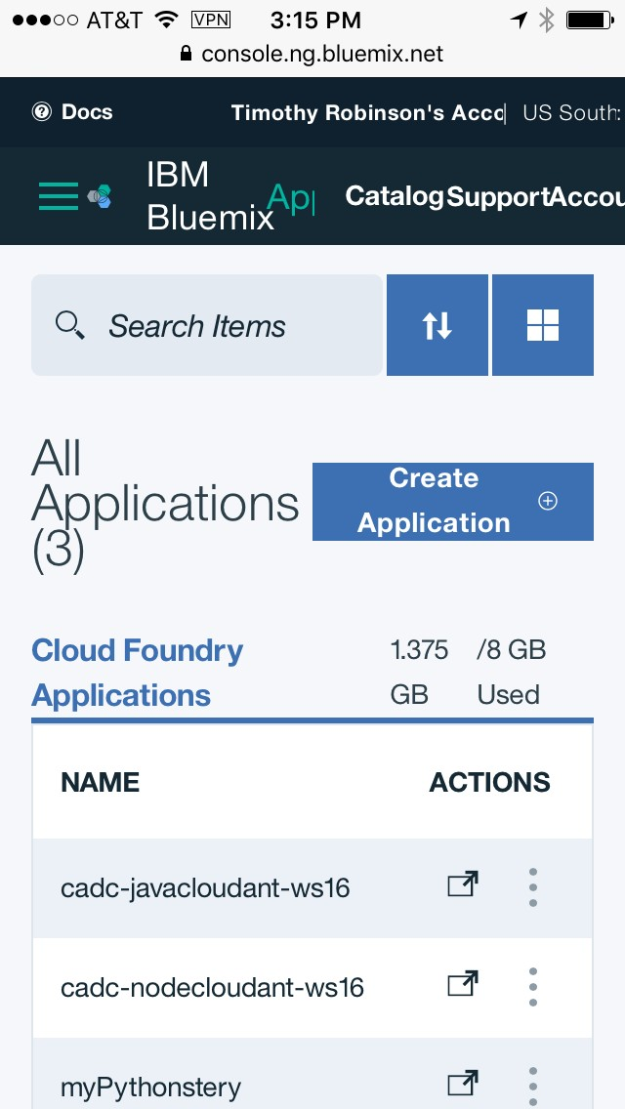


IBM Cloud
The most advanced cloud platform that weaves together services, infrastructure, and data to rapidly bring your ideas to production
3

Slide 4












IBM Cloud
Open-standard, cloud-based platform for building, managing, and running applications of all types (web, mobile, big data, new smart devices, and so on)
Go Live in Seconds
The developer can choose any language runtime or bring their own. Zero to production in one command.
APIs and Services
A catalog of IBM, third party, and open source API services allow the developer to stitch an application together in minutes.
On-Prem Integration
Build hybrid environments. Connect to on-premise assets plus other public and private clouds.
DevOps
Development, monitoring, deployment, and logging tools allow the developer to run the entire application.
Layered Security
IBM secures the platform and infrastructure and provides you
with the tools to secure your apps.
Flexible Pricing
Sign up in minutes. Pay as you go and subscription models offer choice and flexibility.

Slide 5
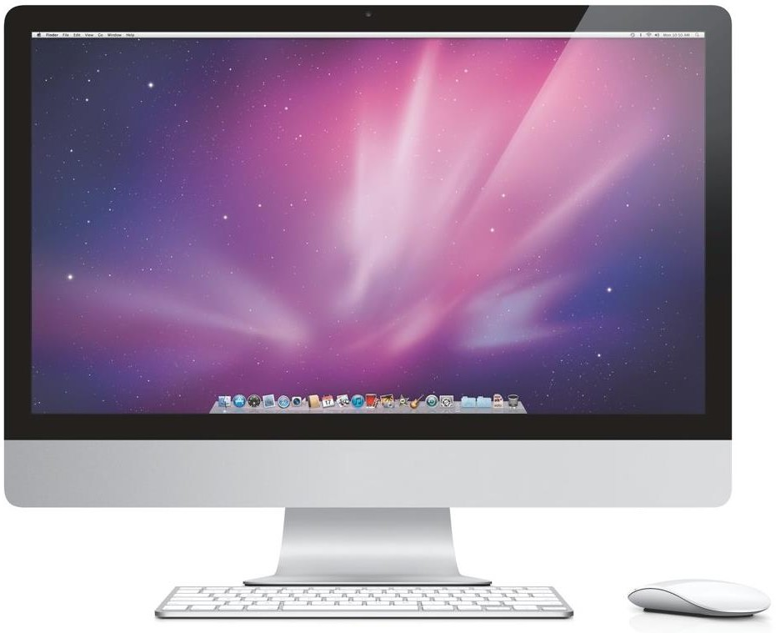
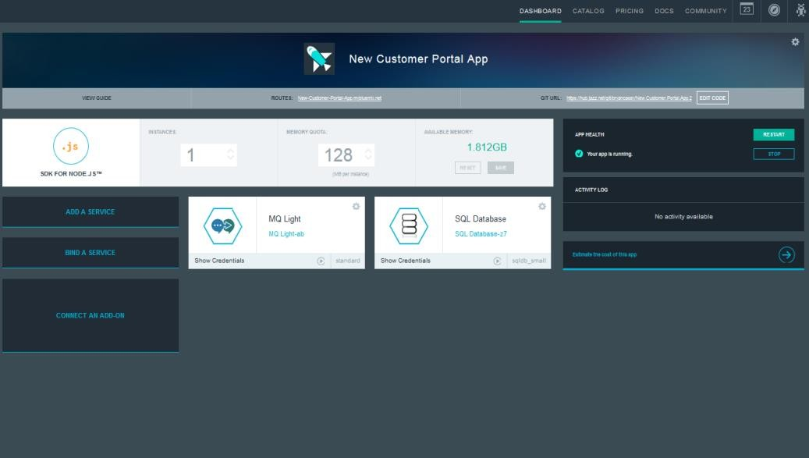

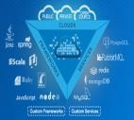
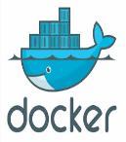
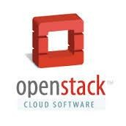
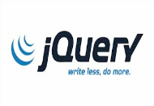

IBM Cloud
Build, run, scale, manage, integrate, and secure applications in the cloud.
Developer experience
Rapidly deploy and scale applications in any language.
Enterprise capability
Securely integrate with existing on-premises data and systems.
Choose from flexible
deployment models.
Manage the full application lifecycle with DevOps.
Develop and deploy on a platform built on a foundation of open technology.
Compose applications quickly with useful APIs and services and avoid tedious backend configuration.
Realize fast time-to-value with simplicity, flexibility, and clear documentation.
Built on a foundation of open
technology
IBM Cloud service categories
DevOps
Big data
Mobile
Watson
Business analytics
Database
Web and application
Security
Internet of Things
Cloud integration
API management and
integration

Slide 6
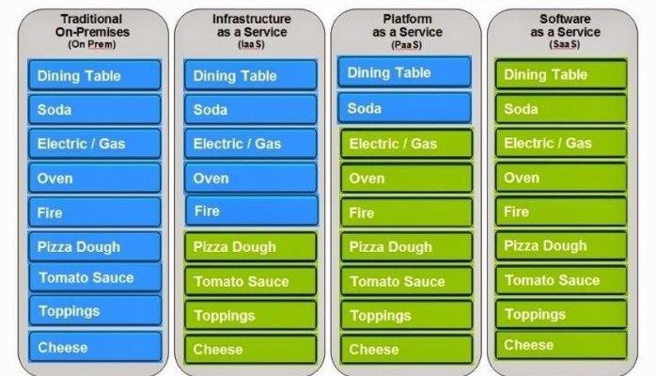
Pizza as a service

Slide 7










From on-premises to IBM Cloud compute and services
PaaS environments simplify various tasks compared to on-premises or IaaS
Traditional On-Premises Infrastructure as a Service Platform as a Service Software as a Service
Applications Data Runtime Middleware O/S Virtualization Servers Storage Networking
Applications Data Runtime Middleware O/S Virtualization Servers Storage Networking
Applications Data Runtime Middleware O/S Virtualization Servers Storage Networking
Applications Data Runtime Middleware O/S Virtualization Servers Storage Networking
Health management
Load balancing
Scaling
Deployment
OS patching
OS security hardening
Developer Manages
Vendor Manages in cloud
Standardization; OPEX savings; faster time to value

Slide 8





What IBM Cloud offers
Compute
Offerings spanning from bare metal to serverless programming
Hybrid
Delivered across public, dedicated, and private (on-premises) deployment models
Global
Available in over 60 Cloud data centers around the globe, 33 dedicated to IBM Cloud Platform workloads
Offers over 170 composable services across Watson, Data, Mobile, IoT and DevOps
Services
Open
Built on open standards and architecture
8

Slide 9







Flexible compute options
Bare Metal
Maximum performance and control
Virtual Server or VMware
Leverage existing languages and tools
Containers
Maximum portability
Cloud Foundry
Open PaaS environment
Cloud Functions
Maximum speed with server-less apps
PERFORMANCE & CONTROL
PORTABILITY
DEVELOPMENT SPEED
4

Slide 10



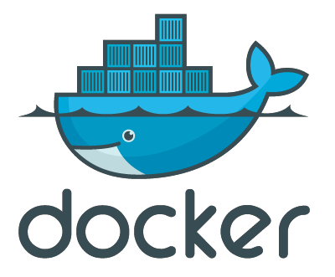
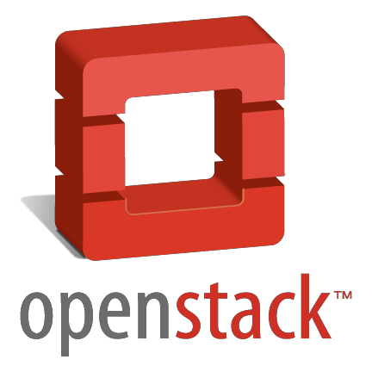

IBM Cloud offers different compute models to “run your code”
Cloud Foundry application
Docker container
Virtual machine
expanding
Flexibility
Level of abstraction
Consistent experience:
Common service binding and consumption model
Common user ID and permissions model
Ability to hook into common routing layer

Slide 11


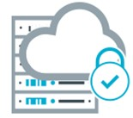

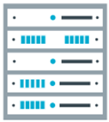

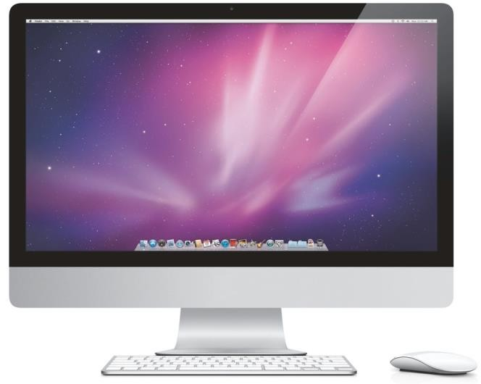

Cloud offering
Public
Dedicated
Private

Slide 12










































What is available

Slide 13

Watson Developer Cloud APIs
Language
Conversation
Discovery
Language Translator Natural Language Classifier
Natural Language Understanding Personality Insights
Tone Analyzer
Data Insights
Discovery Discovery News
Speech
Speech to text Text to speech
Vision
Visual Recognition
https://www.ibm.com/watson/developercloud

Slide 14
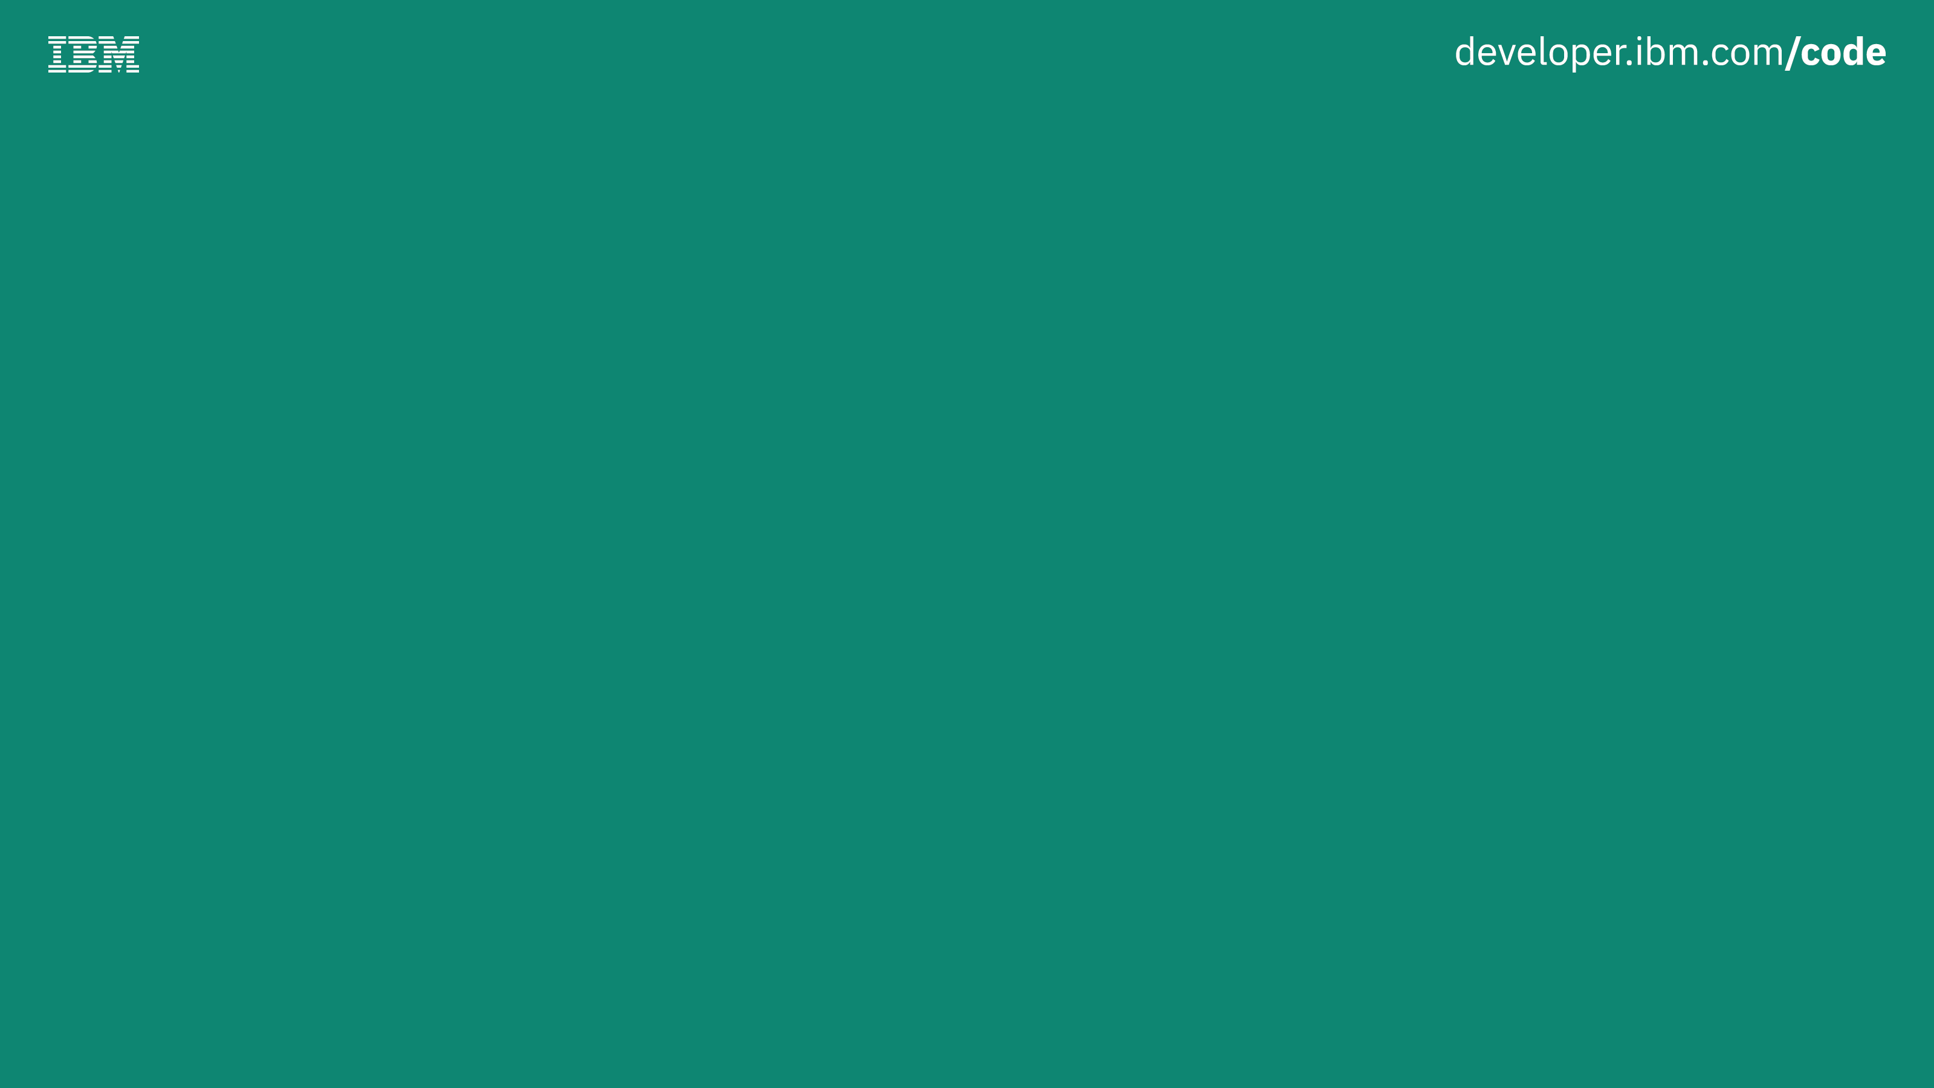

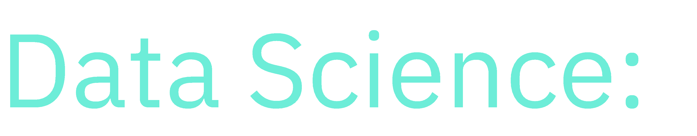



Slide 15
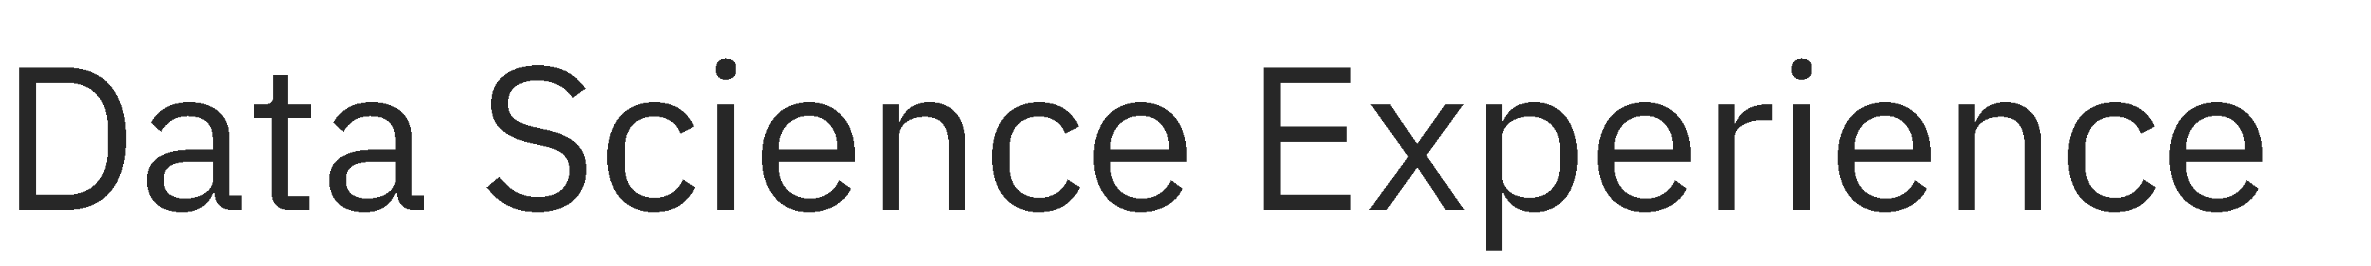

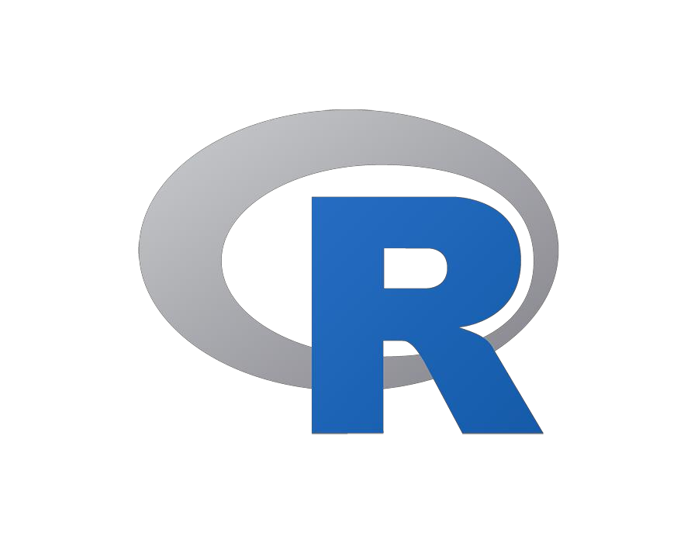
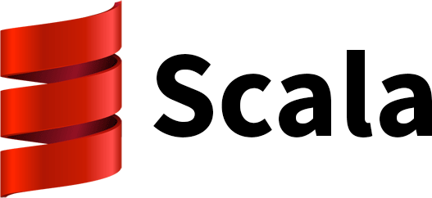
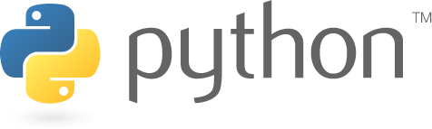


Slide 16
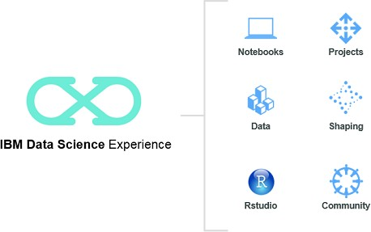
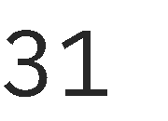

Slide 17
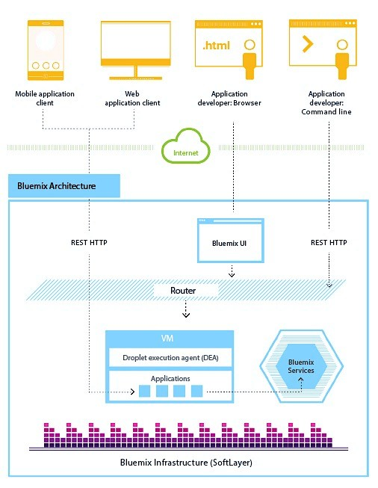
IBM Cloud Architecture
Users access your application from web or mobile
Manage your app with web browser or CLI
Build local with text editor or Eclipse, then deploy
Or… build with web UI on DevOps Toolchains

Slide 18
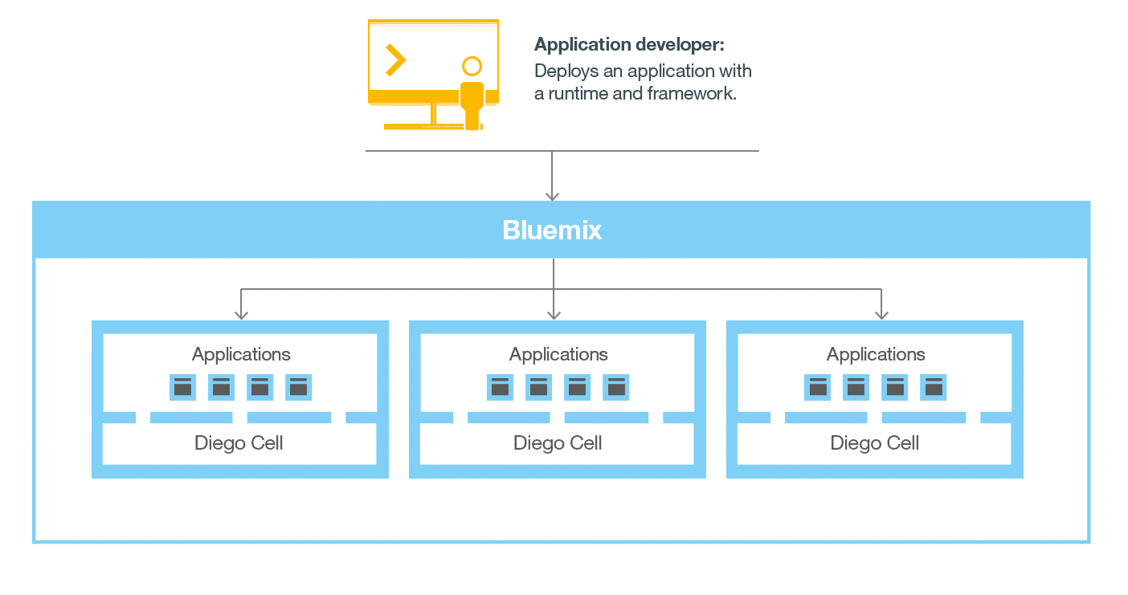
IBM Cloud Application Lifecycle
Upload application components and metadata
Create and bind services
Stage application
Deploy application
Manage application health

Slide 19
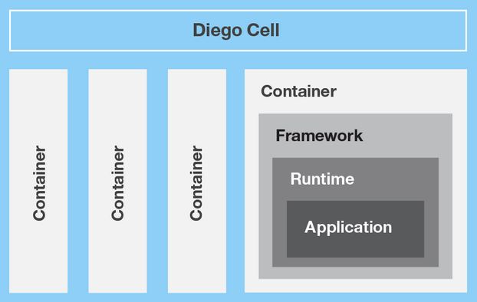
Diego – Container Management System
Application manager
Communicates with the rest of the IBM Cloud infrastructure
Manages apps deployed to the virtual server
Containers
Separate and protect apps
IBM Cloud will install the appropriate framework and runtime required

Slide 20
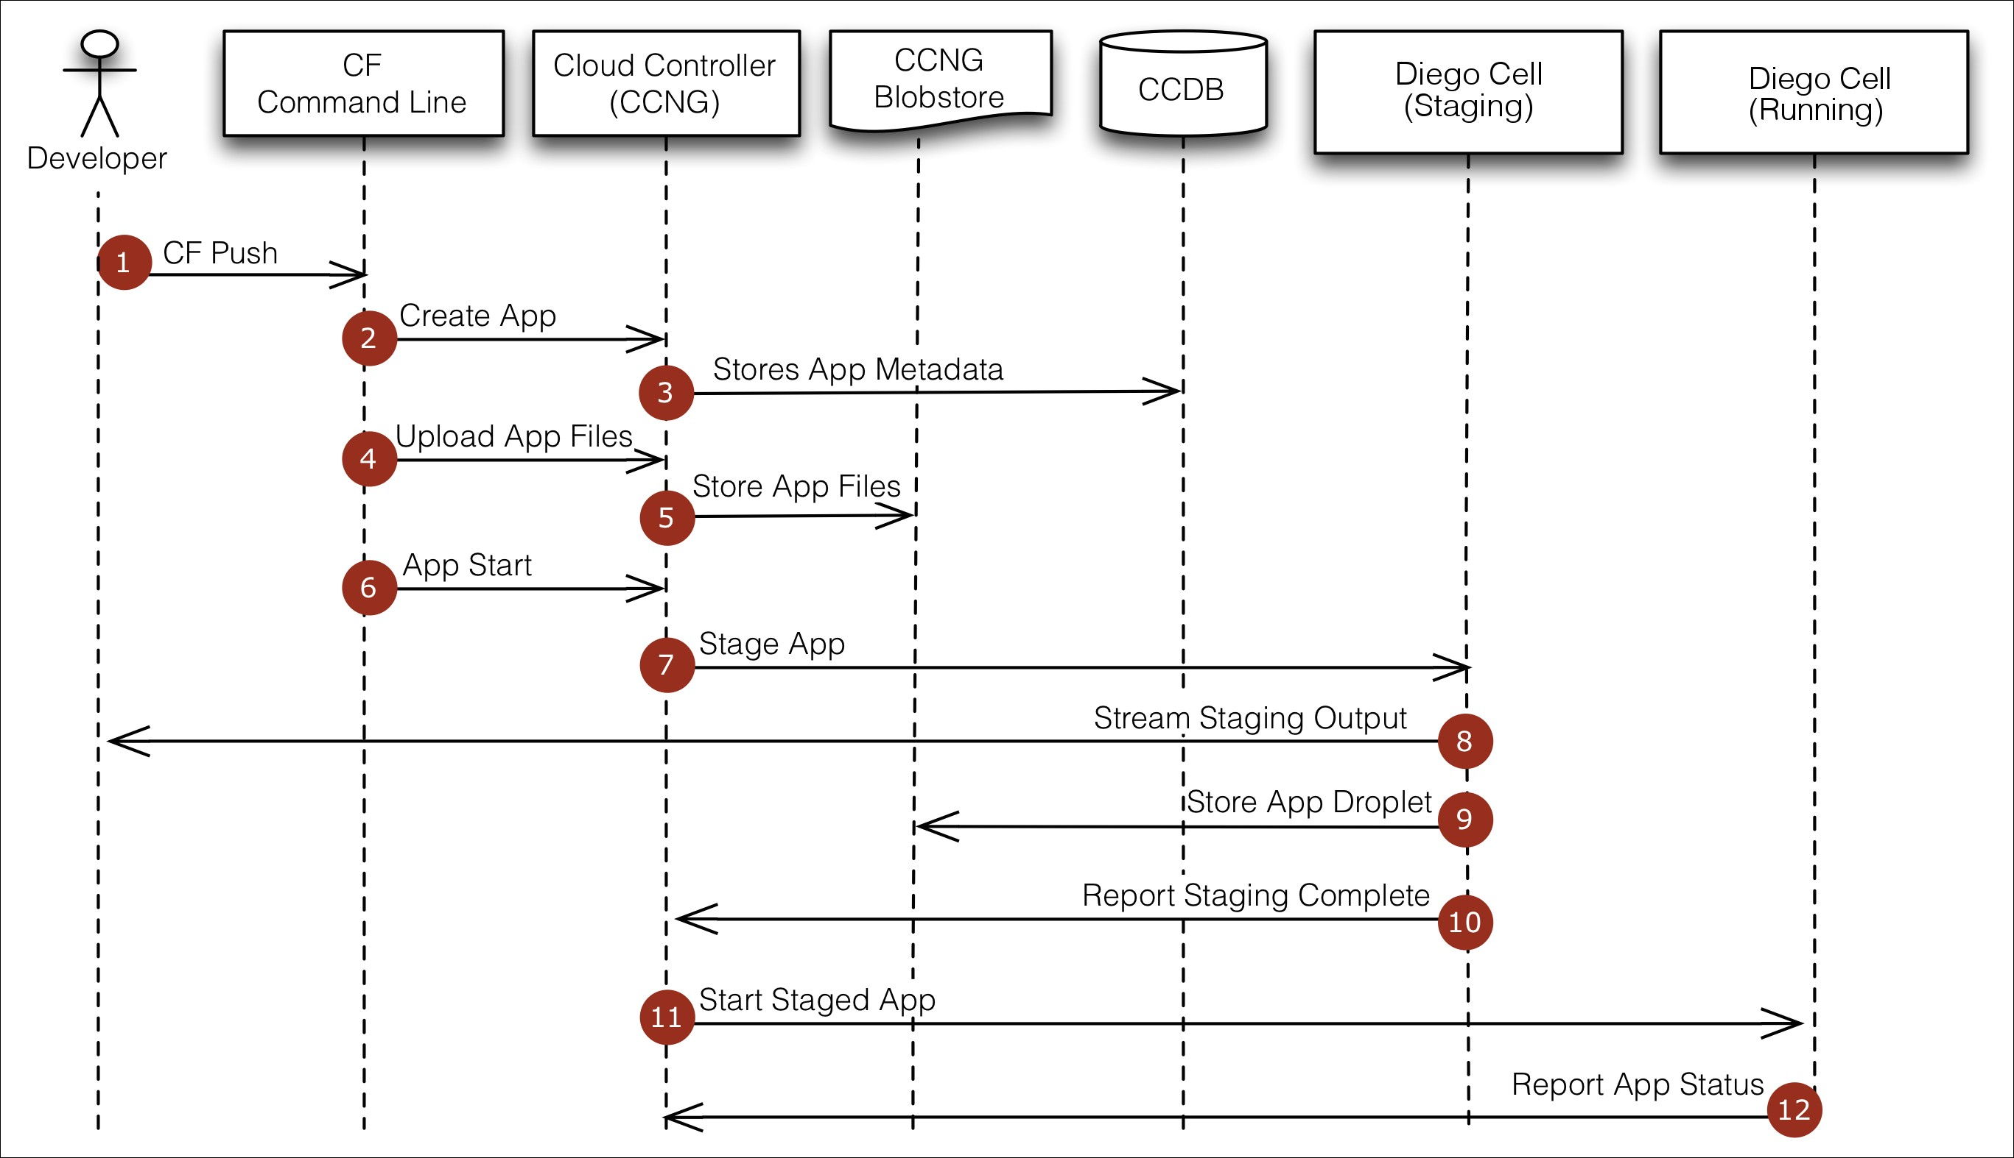
Application staging and deployment
Reference: http://docs.cloudfoundry.org/concepts/how-applications-are-staged.html

Slide 21


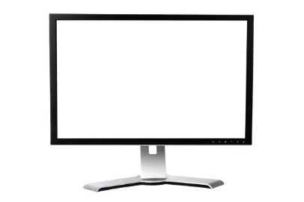



IBM Cloud public regions
Stand-alone cloud with catalog, apps, and services
Maximum isolation from entities in other regions
us-south
https://console.ng.bluemix.net https://api.ng.bluemix.net
eu-gb
https://console.eu-gb.bluemix.net https://api.eu-gb.bluemix.net
sydney
https://console.au-syd.bluemix.net https://api.au-syd.bluemix.net
eu-de
https://console.eu-de.bluemix.net https://api.eu-de.bluemix.net

Slide 22




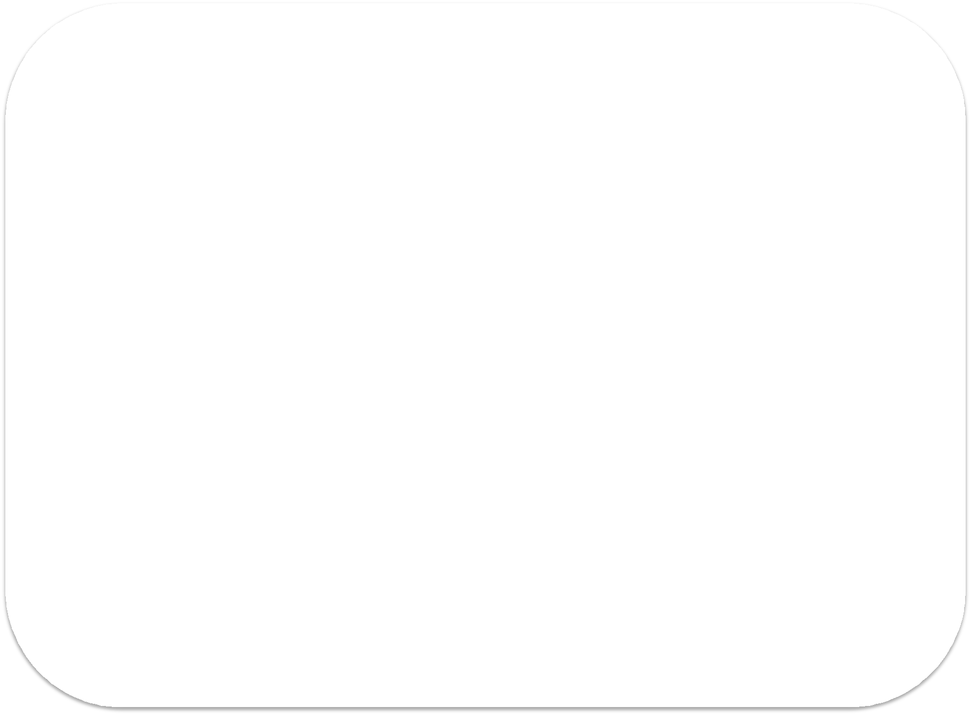



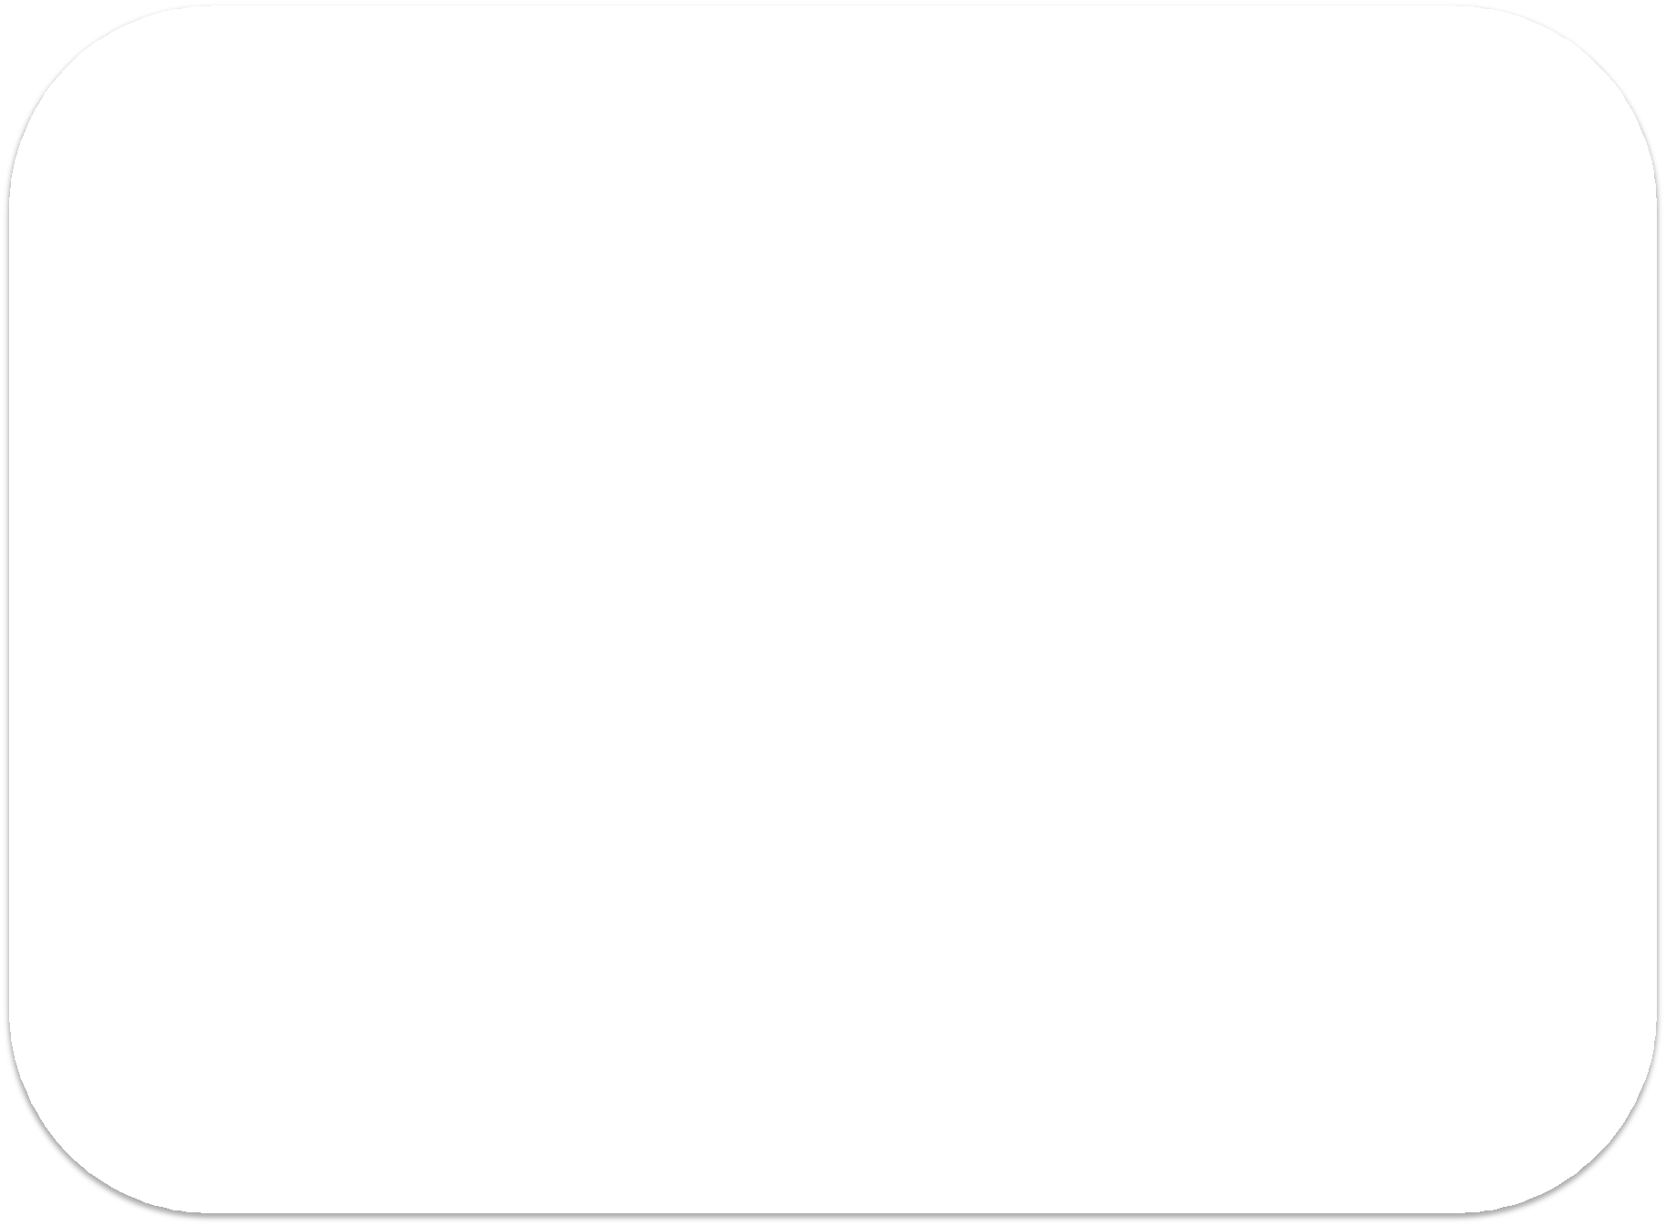


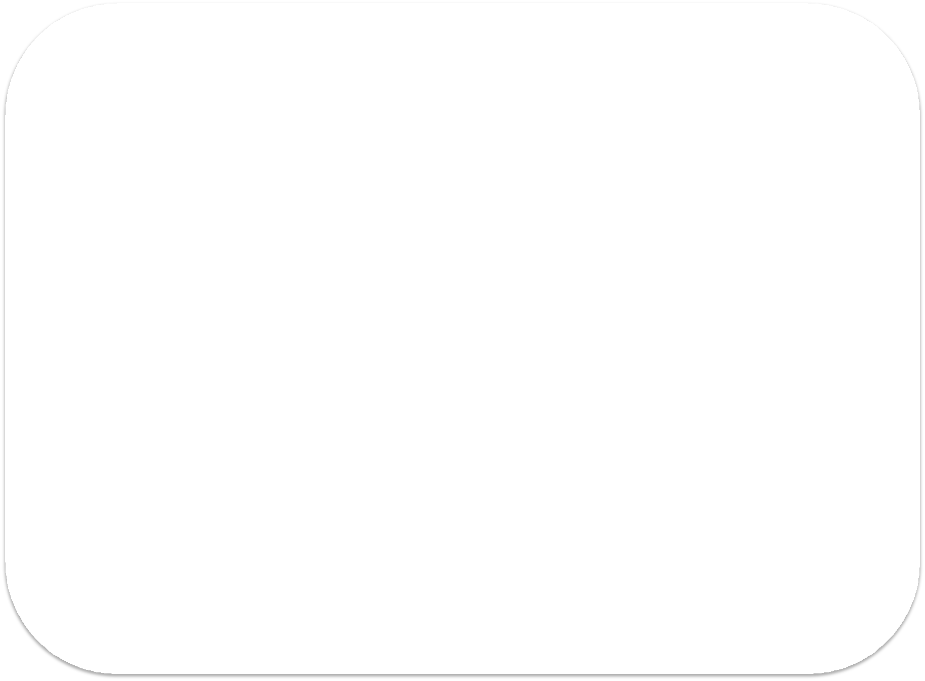

























Account and organization model
Account – Anchor point for billing
Organization
•
E^{E}n^{n}aªb^{b}le^{le}s^{s}t^{t}e^{e}aªm^{m}c^{c}oºlla^{la}b^{b}oºr^{r}aªt^{t}io^{io}n^{n}
Spaces
_{U}U_{s}s_{e}e_{r}r
User
Space
Space
Space
Apps
Containers
VMs
Services

Slide 23
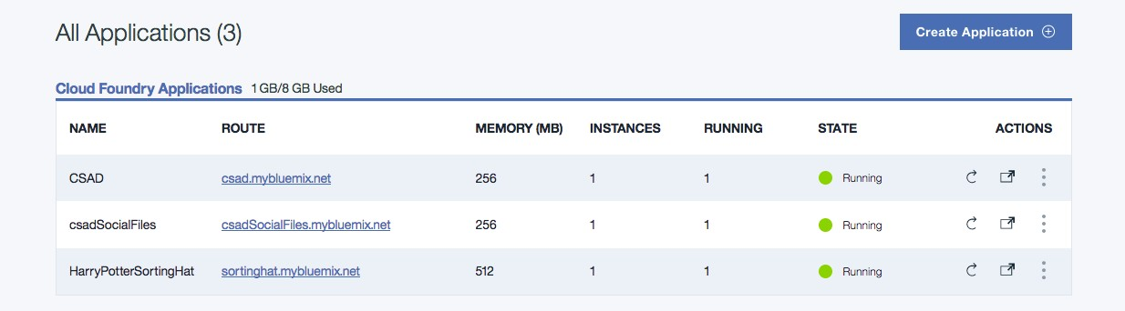
Dashboard
Allows you to create, view and manage your apps and services
Manage organizations and spaces
Organization: grouping methodology for users
Space: sub-grouping to hold apps and services

Slide 24
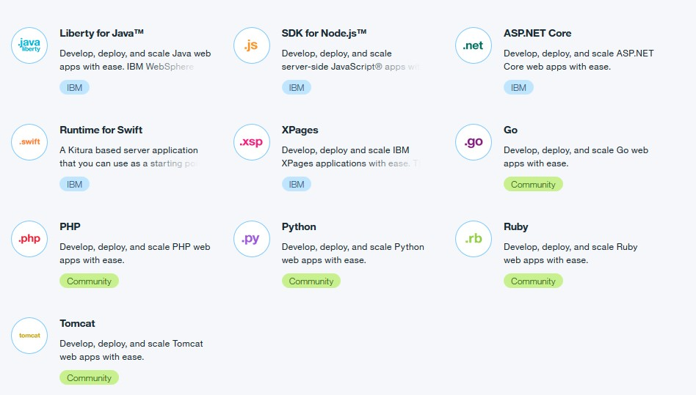
Application runtimes and buildpacks
Cloud Foundry Buildpacks
Specific runtime
Build framework
Types:
IBM
Cloud Foundry Community
External (bring your own!)

Slide 25
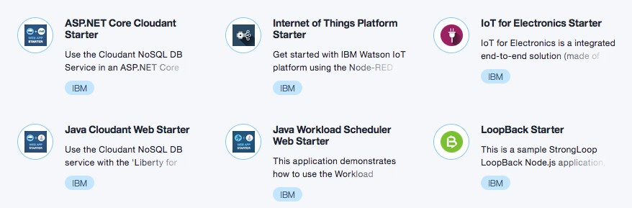
Boilerplates
Boilerplates are used to get up and running quickly by generating application templates
A sample application
The associated runtime environment
Any predefined services to accomplish a specific task

Slide 26
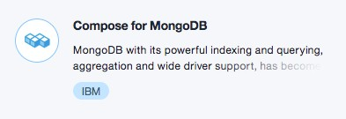
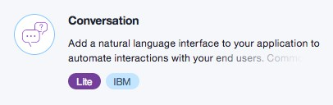
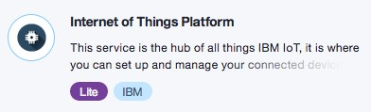
Services
Cloud extension that provides ready-for-use functionality
Can add single or multiple services to any application
Services Catalog:
Data & Analytics
Watson
Internet of Things
APIs
Network
Storage
Security
DevOPs
Application Services
Integrate

Slide 27
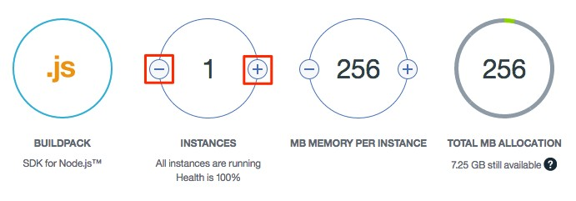
Resilience
IBM Cloud is designed to host scalable resilient apps and application artifacts that scale to meet your needs, remain highly available, and be quick to recover from problems
You can have one or more instances running for your app
App uploaded only once, deployed across multiple virtual servers
Best practice: use at least three instances for app to ensure availability

Slide 28
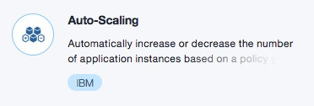
Auto-Scaling service
IBM Cloud allows you to automatically manage application capacity using the DevOps Auto-Scaling service
Can be added to any deployed application in IBM Cloud
Automatically increases or decreases compute capacity
Create policies to specify conditions that trigger scaling activities, such as changes to the application’s:
Heap, Memory, Response Time, Throughput, etc.

Slide 29
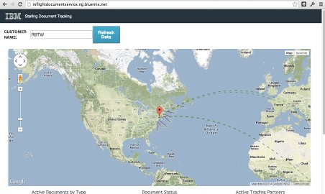
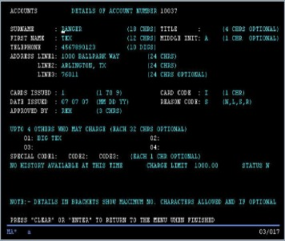

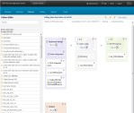
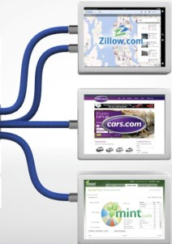

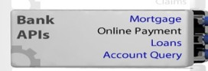
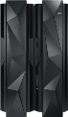
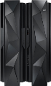

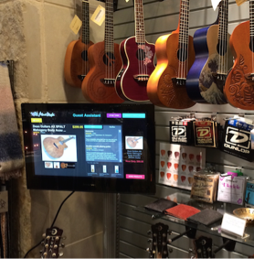


How will you use it?
Extend existing applications
Add user experience such as mobile, social
Add new capabilities integrating other services and APIs
Do rapid experimentation for new capabilities
API-enable applications
Scalable API layer on top of existing services
Simplify how composite service capabilities are exposed through APIs
New applications
Systems of Engagement
Internet of Things
API creation and management
Backend systems and integration
New channels and opportunities

Slide 30
Cloud Solution approach – 12 app factor https://12factor.net/
Codebase - One codebase tracked in revision control, many deploys
1-1 relationship between app & code repo – use packages for shared code
Dependencies – Declared and isolated (no system wide dependencies)
Config - Store config in the environment (not in constants in the app)
Backing Services - Treat backing services as attached resources
Can be attached and reattached w/o affecting code, no differentiation between local and remote
Build, release, run - Strictly separate build and run stages
Release has unique id
Processes - Execute the app as one or more stateless processes
State shared via external services – no sticky sessions !
Port binding - Export services via port binding
In deployment, a routing layer handles routing requests from a public-facing hostname
Concurrency - Scale out via the process model
Disposability - Maximize robustness with fast startup and graceful shutdown
Dev/Prod parity - Keep development, staging, and production as similar as possible
Logs - Treat logs as event streams
Admin processes - Run admin/management tasks as one-off processes

Slide 31


Cloud Security

Slide 32


Slide 33


Slide 34
Compliance

Slide 35








https://www.ibm.com/cloud/compliance/

Slide 36


https://developer.ibm.com/code
Signup for IBM Cloud
https://bluemix.net

Slide 37






Stay Connected and continue coding !
Join Data Science Experience now !
https://datascience.ibm.com/
Code & instructions
https://github.com/watson-developer-cloud
https://github.com/IBM
https://github.com/IBM-Bluemix
https://ibm-cloud.github.io
http://ibm.github.io
Join our Meetup group
Bangalore : https://www.meetup.com/IBMDevConnect-Bangalore
developerWorks India Community
https://developer.ibm.com/in
Join our Slack team and stay in touch with the experts
https://ibmdevconnect.slack.com
Send in your request http://ibm.biz/slackrequest
Recipes
https://developer.ibm.com/recipes/

Slide 38

Thank You
Sudharshan Govindan
Developer Advocate
Email : sudharshan.govindan@in.ibm.com
Twitter : @sudhargovindan

